Slide 1
Lecture-2 Microprocessor Historical Background Microcontrollers – Embedded Systems
An embedded system is a special-purpose computer system designed to perform one or a few dedicated functions often with real-time
An integrated device which consists of multiple devices
Microprocessor (MPU)
Memory
I/O (Input/Output) ports
Often has its own dedicated software

Slide 2
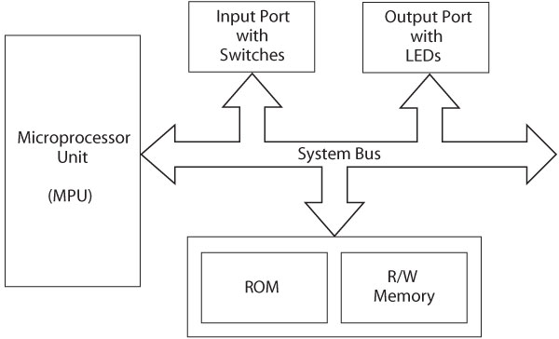
Microprocessor-Based Systems
• Central Processing Unit (CPU)
• Memory
• Input/Output (I/O) circuitry
• Buses
– Address bus
– Data bus
– Control bus

Slide 3
MPU
CLK
CPU
Reg
CPU
Ahritmetic Logic
Unit
Register
Arrays
Microprocessor-based System
Control Unit

Slide 4
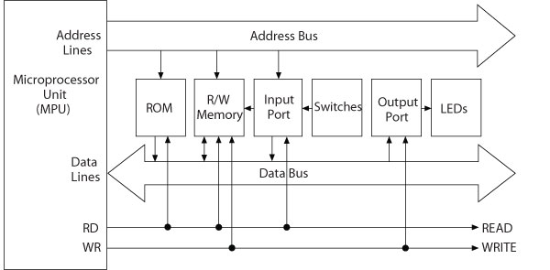
Microprocessor-Based System with Buses: Address, Data, and Control

Slide 5
Microprocessor-based Systems Microprocessor
The microprocessor (MPU) is a computing and logic device that executes binary instructions in a sequence stored in memory.
Characteristics:
General purpose central processor unit (CPU)
Binary
Register-based
Clock-driven
Programmable
Notes:
5

Slide 6
Microprocessor-based Systems Microprocessor
Arithmetic Logic
Unit
Register
Arrays
Control Unit
ALU performs computing tasks – manipulates the data/ performs numerical and logical computations
Registers are used for temp. storage
Control unit is used for timing and other controlling functions – contains a program counter (next instruction’s address and status register)
System software: A group of programs that monitors the functions of the entire system
the “brains” of the computer
its job is to fetch instructions, decode them, and then execute them
8/16/32/etc –bit (how it moves the data
contains:
Notes:
6

Slide 7
Microprocessor-based Systems Memory
Memory is a group of registers
16 register – address: 0-15 – in binary: 0-1111; Address lines: A0-A3
Serves two major purposes
storing the binary codes for the sequence of instructions specified by programs (program)
storing binary data that the computer needs to execute instructions (data)
Notes:
7

Slide 8
Microprocessor-based Systems Memory Types
R/W: Read/Write Memory; also called RAM
It is volatile (losses information as power is removed)
Write means the processor can store information
Read means the processor can receive information from the memory
Acts like a Blackboard!
ROM: Read-Only memory;
It is typically non-volatile (permanent) – can be erasable
It is similar to a Page from your textbook
Notes:
8

Slide 9
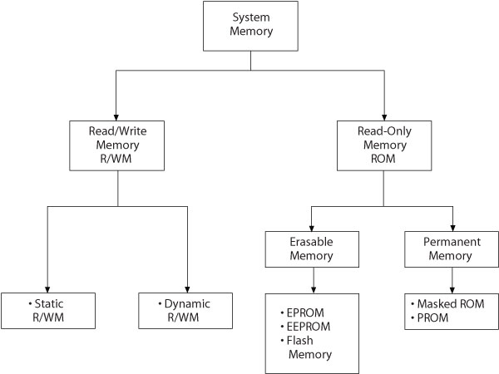
Microprocessor-based Systems Memory Classification
Basic Technologies:
Semiconductor
Magnetic
Optical
(or combination)
Expensive
Fast/
Cheap
Slow
Onetime programmable
Electronically Erasable
PROM
Notes:
9

Slide 10
Microprocessor-based Systems Memory Classification
one transistor and one capacitor to store a bit
Leakage problem, thus requires refreshing
Used for dynamic data/program storage
Cheap and slow!
4/6 transistor to save a single bit
Volatile
- Fast but expensive
Expensive
Fast/
Cheap
Slow
Onetime programmable
Electronically Erasable
PROM
Notes:
10

Slide 11
Erasable ROMs
Marked Programmed ROM
Programmed by the manufacturer
Programmable ROM (PROM)
Can be programmed in the field via the programmer
Erasable Programmable ROM (EPROM)
Uses ultraviolet light to erase (through a quartz window)
OTP refers to one-time programmable
Electrically Erasable Programmable ROM (EEPROM)
Each program location can be individually erased
Expensive
Requires programmer
FLASH
Can be programmed in-circuit (in-system)
Easy to erase (no programmer)
Only one section can be erased/written at a time (typically 64 bytes at a time)

Slide 12
Microprocessor-based Systems I/O Ports
The way the computer communicates with the outside world devices
I/O ports are connected to Peripherals
Peripherals are I/O devices
Input devices
Output devices
Examples
Printers and modems,
keyboard and mouse
scanner
Universal Serial Bus (USB)
Notes:
12

Slide 13
Microprocessor-based Systems – With BUS

Slide 14
Microprocessor-based Systems - BUS
The three components – MPU, memory, and I/O – are connected by a group of wires called the BUS
Address bus
consists of 16, 20, 24, or 32 parallel signal lines (wires) - unidirectional
these lines contain the address of the memory location to read or written
Control bus
consists of 4 to 10 (or more) parallel signal lines
CPU sends signals along these lines to memory and to I/O ports
examples: Memory Read, Memory Write, I/O Read, I/O Write
Data bus
consists of 8,16, or 32 parallel signal lines
bi-directional
only one device at a time can have its outputs enabled,
this requires the devices to have three-state output

Slide 15
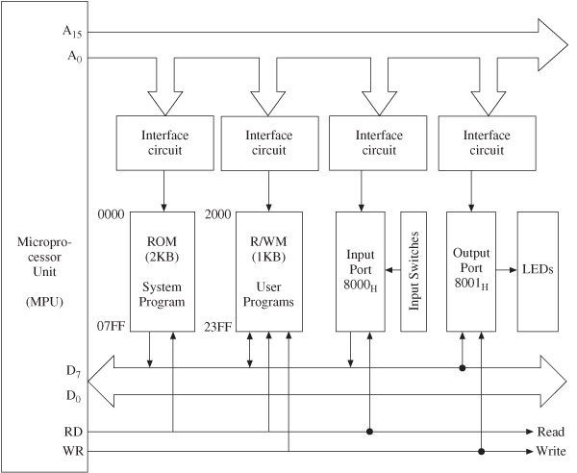
Expanded Microprocessor-Based System
Remember: 111 1111 1111 = 2^11=2K
Note the directions of busses
What is the width of the address bus?
What is the value of the Address bus to access the first register of the R/W M?
You must know how to
draw it!
Notes:
15

Slide 16
Embedded controllers
Used to control smart machines
Examples: printers, auto braking systems
Also called microcontrollers or microcontroller units (MCU)

Slide 17
Embedded controllers Software Characteristics
No operating systems
Execute a single program, tailored exactly to the controller hardware
Assembly language (vs. High-level language)
Not transportable, machine specific
Programmer need to know CPU architecture
Speed
Program size
Uniqueness

Slide 18
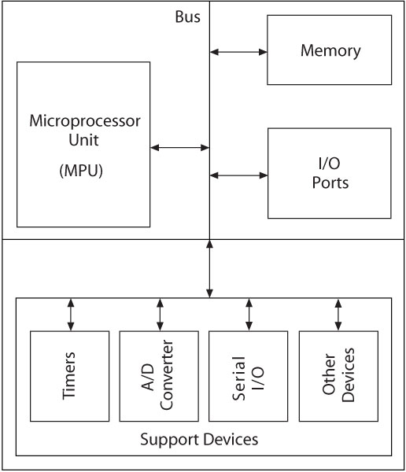
Microcontroller Unit (MCU) Block Diagram
An integrated electronic computing and logic device that includes three major components on a single chip
Microprocessor
Memory
I/O ports
Includes support devices
Timers
A/D converter
Serial I/O
Parallel Slave Port
All components connected by common communication lines called the system bus.

Slide 19
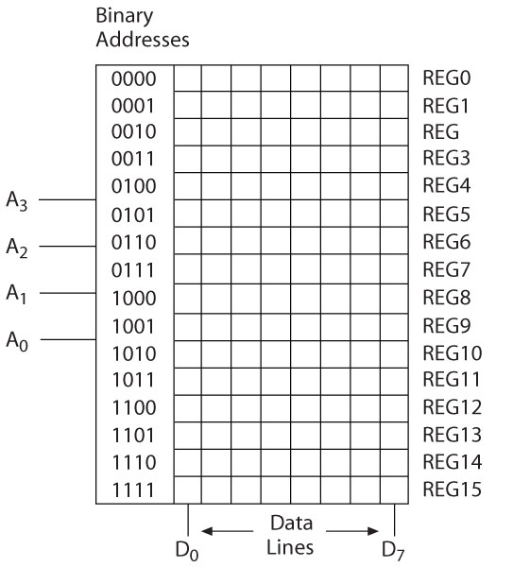
Memory
A semiconductor storage device consisting of registers that store binary bits
Two major categories
Read/Write Memory (R/WM)
Read-only-Memory (ROM)

Slide 20
Storing Bits in Memory
We can store in different memory types
EEPROM, FLASH, RAM, etc.
In an 8-bit RAM
Each byte is stored in a single memory register
Each word is stored in two memory locations (registers)
DATA 0x1234
0x12→REG11 (High-order byte)
0001 0010
0x34→REG10 (Low-order byte)
0011 0100
What if we want to store -8?
Remember -8→111 1000 (in two’s complement)

Slide 21
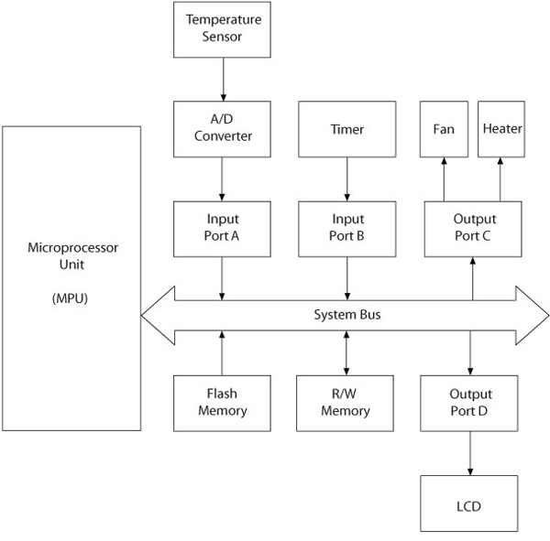
MPU-Based Time and Temperature System

Slide 22
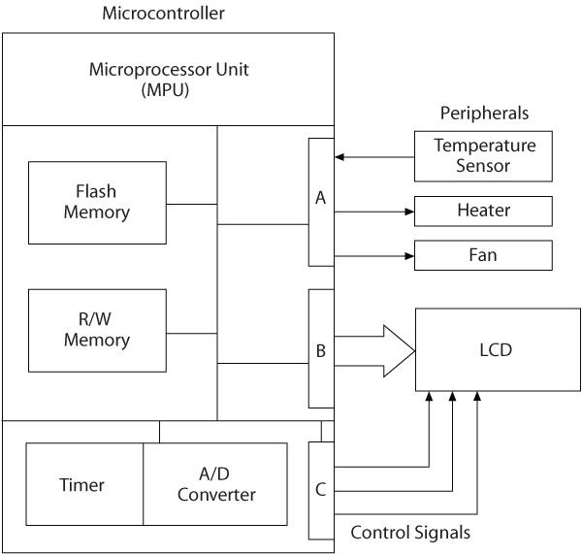
MCU-Based Time and Temperature System

